Slide 1
Week 31 Assignment Summary
Ram Sundar

Slide 2
Objectives
Understand the structure of the Twitter dataset
Perform data preprocessing and text cleaning
Conduct exploratory data analysis to uncover insights
Build a Recurrent Neural Network (RNN) model for sentiment classification
Evaluate and improve the performance of the model
Present findings and recommendations

Slide 3
Dataset Overview
Standard CSV without headers
Appears to be from multiple sources
Dataset observations
  Total Rows: 74681
  Total Columns: 4
  Duplicate Rows: 2700 (3.62%)
  Total Missing Values: 686
  Completely Empty Rows: 0
Dataset after post processing
  Total Rows: 57296
  Total Columns: 2
  Duplicate Rows: 0 (0.00%)
  Total Missing Values: 0
  Completely Empty Rows: 0

Slide 4
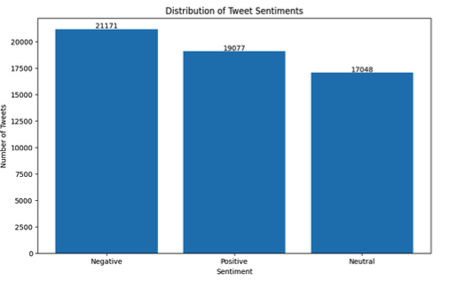
EDA – Key findings – Sentiment distribution

Slide 5
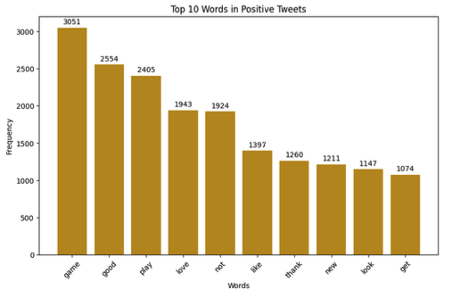
EDA – Key findings – top 10 Positive keywords

Slide 6
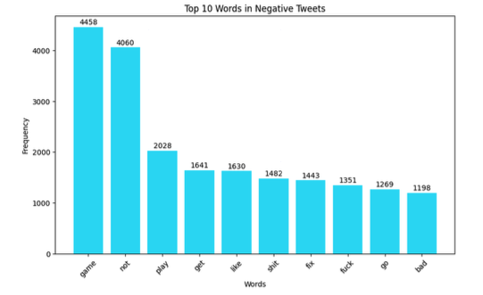
EDA – Key findings – top 10 Negative keywords

Slide 7
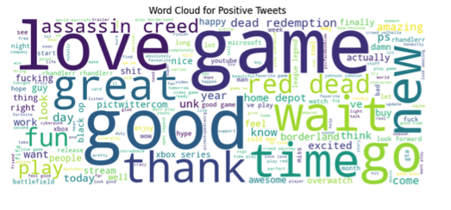
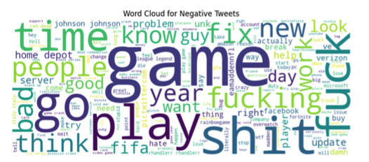
EDA – Key findings – word clouds

Slide 8
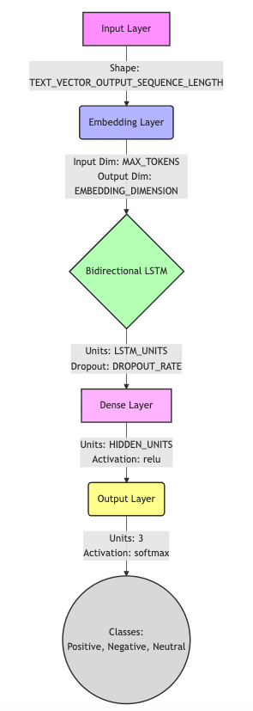
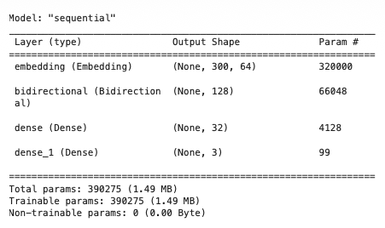
RNN model build - Methodology
Layers

Slide 9
Eval results and performance metrics

Slide 10
Challenges faced & Model improvement

Slide 11
Sample tweet demonstration

